Slide 1
Delivery Data Analysis
Tarisha & Fakhrie
June 2023

Slide 2
Overview
This report provides an overview of the delivery data analysis for a company's branch in one Region over a one-month period, using Google Spreadsheet. The dataset consists of customer data, delivery data, and driver performance data. From this analysis, valuable insights can be derived regarding the delivery status, cost, driver performance, and delivery time. The objective of this overview is to gain a comprehensive understanding of the key aspects and trends in delivery operations, enabling informed decision-making and optimization of the delivery processes.

Slide 3
Data Pre-Processing
There are a total of 14 missing values in the dataset, with 6 in the delivery cost column and 8 in the delivery rating column. The cause of the missing values in the delivery cost column is unknown, but they have been cautiously filled using the imputing missing value technique by generating the delivery cost based on the average of cases where the distance and weight are the same. On the other hand, the null values in the delivery rating column are due to failed deliveries.
There are no error values present in the dataset.

Slide 4
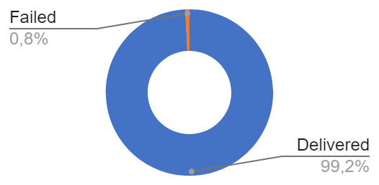
Status
The company successfully delivered 99% of its deliveries, with a total of 978 successful deliveries and only 8 failures within one month.
delivery_status | Total | Percentage
Delivered | 978 | 99,19%
Failed | 8 | 0,81%
Grand Total | 986 | 100,00%

Slide 5
Cost
The average delivery cost is Rp19,942, indicating the typical cost for a delivery
The median delivery cost is Rp16,000, representing the middle value in the distribution of costs
The minimum delivery cost recorded is Rp12,000, reflecting the lowest cost observed
The maximum delivery cost is Rp82,000, signifying the highest cost recorded
The total sum of all delivery costs is Rp19,502,800, representing the overall revenue on deliveries during the analyzed period
Delivery Cost Analysis
AVERAGE | Rp19.942
MEDIAN | Rp16.000
MIN | Rp12.000
MAX | Rp82.000
SUM | Rp19.502.800

Slide 6
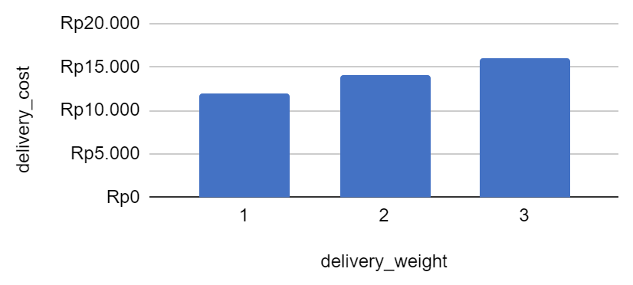
Cost
It is evident that the delivery cost remains consistent with variations in both the weight and delivery distance factors.
Each additional unit of weight results in an increase in price by 2000 rupiah
delivery_distance(KM) | delivery_weight | delivery_cost
1 | 1 | Rp12.000
1 | 1 | Rp12.000
1 | 1 | Rp12.000

Slide 7
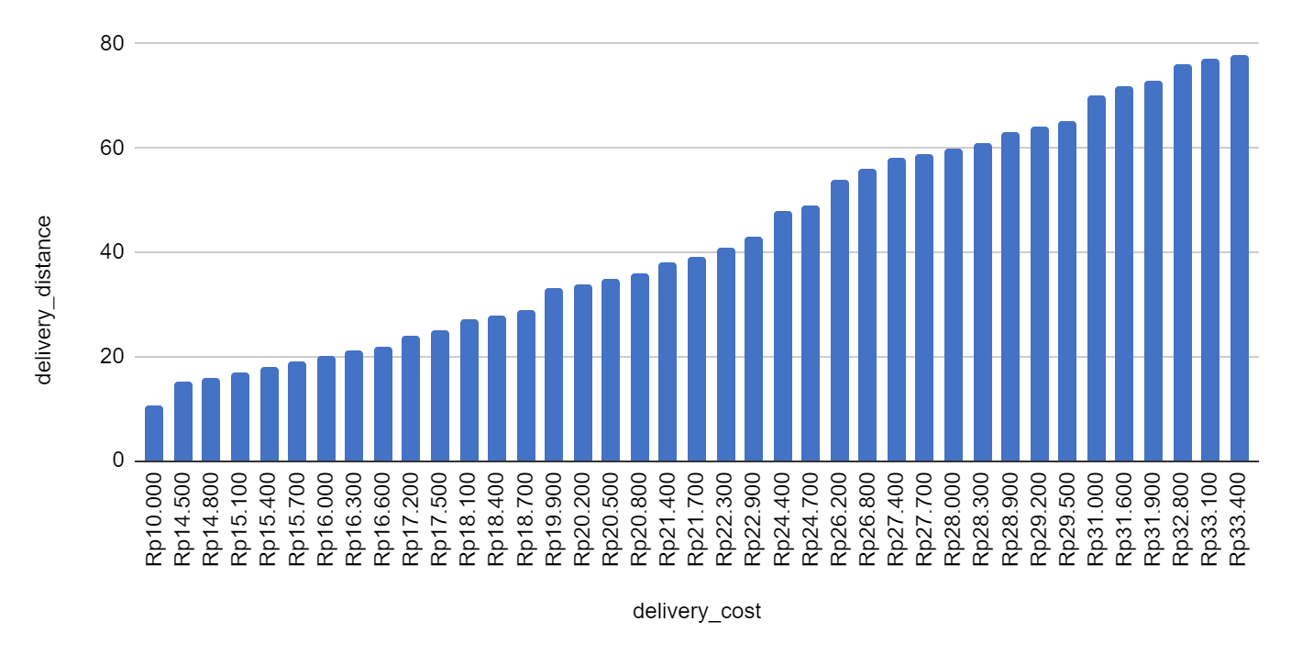
Cost
We can eliminate the influence of weight on the price by subtracting the weight multiplied by 2000
It can be observed that for distances of 1-14km, the price is not affected.
However, for distances greater than 14km, there is an additional charge of 300 Rupiah per kilometer

Slide 8
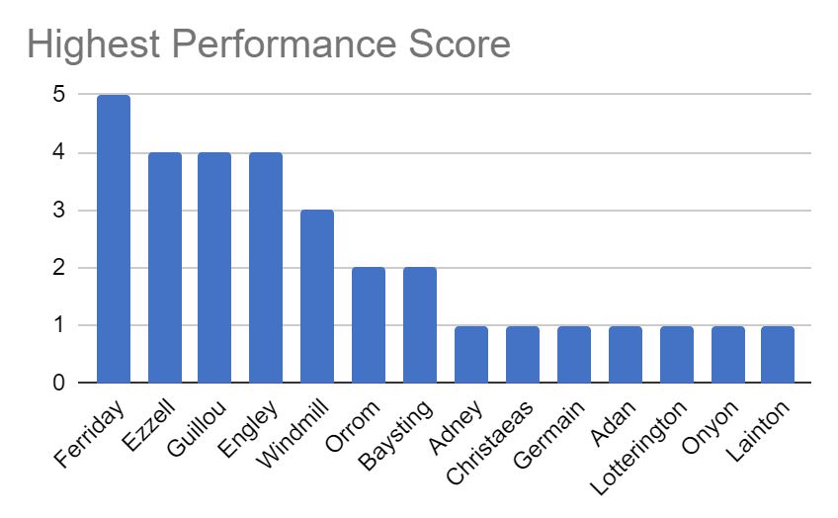
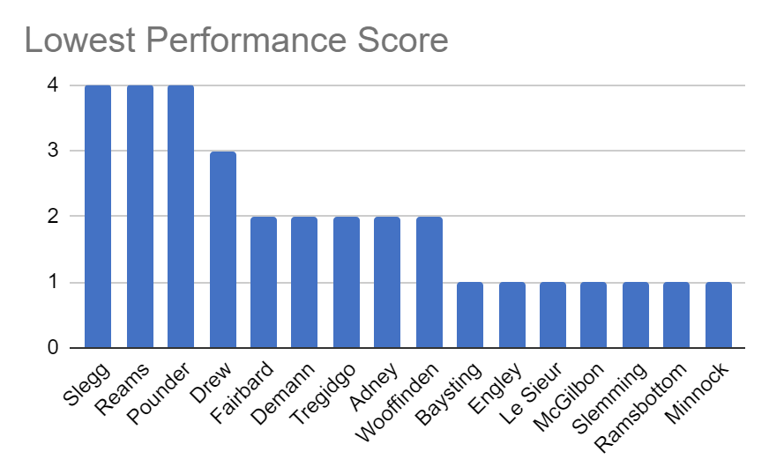
Performance
I obtained driver performance information based on total deliveries, average rating, average delivery cost, total delivery cost, delivery weight, and distance trip. Additionally, I identified the following driver names based on the aforementioned criteria, which can be used by the company for recognition or driver evaluation purposes.
*Higher the number indicates better performance
*Higher the number indicates poorer performance.

Slide 9
Time
General Analyis
AVERAGE of delivery_time | 2,879310345
MEDIAN of delivery_time | 3
MIN of delivery_time | 1
MAX of delivery_time | 5
Based on the vehicle type, distance traveled, and delivery weight, the delivery time remains consistent between 1 and 5 days, with an average of 3 days.

Slide 10
Thank you

